Slide 1

Year 2
Information Meeting

Slide 2
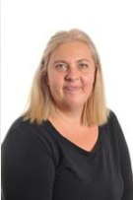
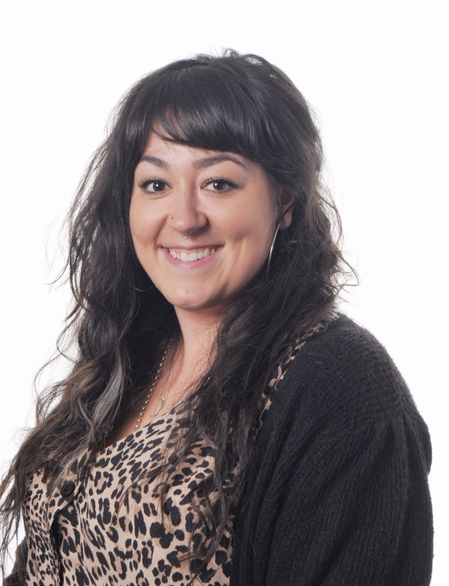
Meet the Staff...
Catbells
Mrs Joanne Cocksedge
Miss Maria Bibby

Slide 3
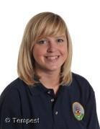
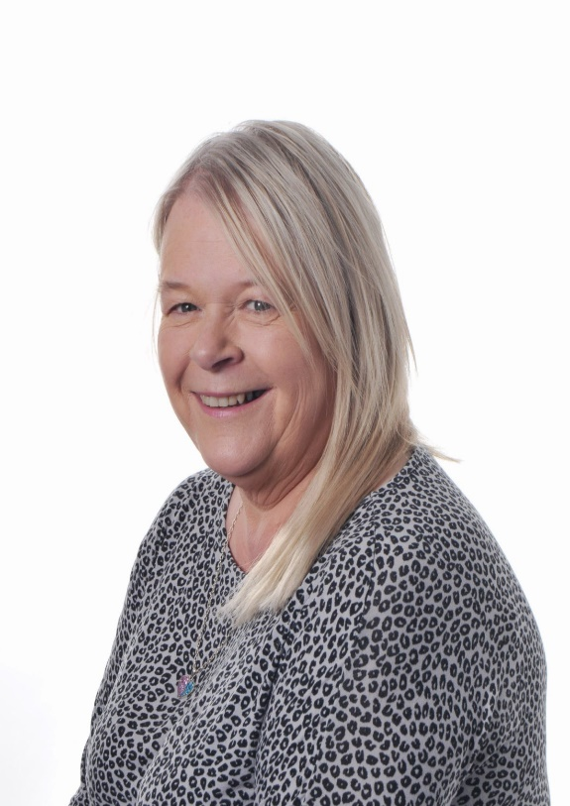
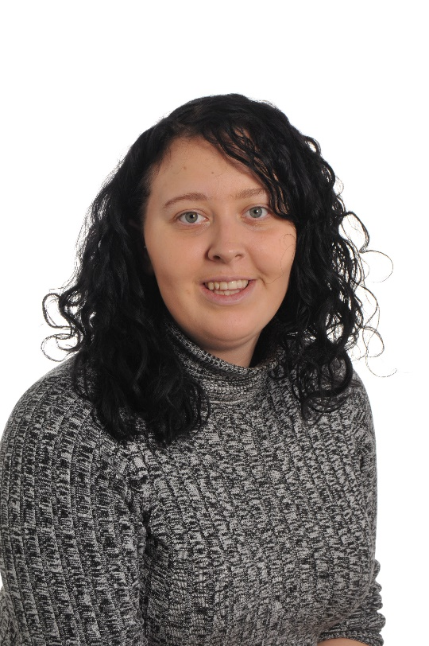
Meet the Staff...
Scafell
Mrs Jenny King
Miss Eloise Cocksedge
Mrs Sandra Austin

Slide 4
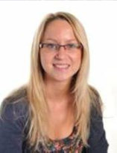
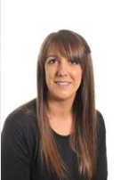
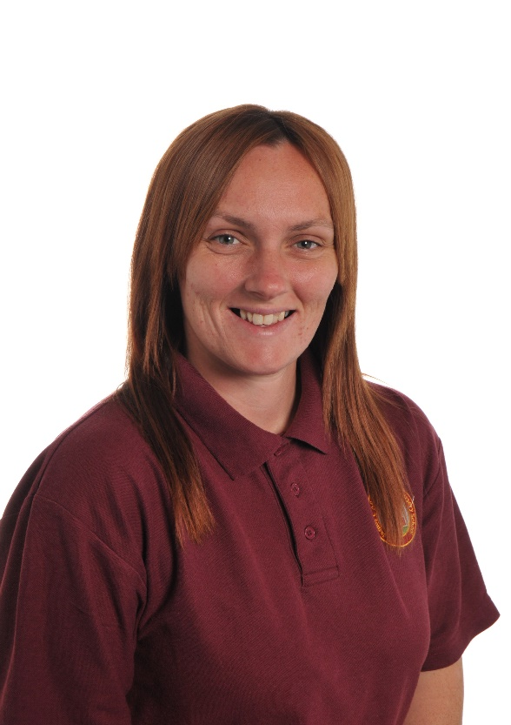
Meet the Staff...
Skiddaw
Mrs Emma Butterworth
Miss Kimberley
Powell
Miss Jemma
Deans

Slide 5

Transition from Y1
Notes:
It’s always a big jump from Reception to Year 1
Aware that this year is very different to previous years! Focus on wellbeing and building relationships.
Key Stage 1 is more structured than the Early Years.
Focus on becoming more independent learners.
Expectations of children are very high, which we need to ensure they are able to access the curriculum set by the Government.

Slide 6
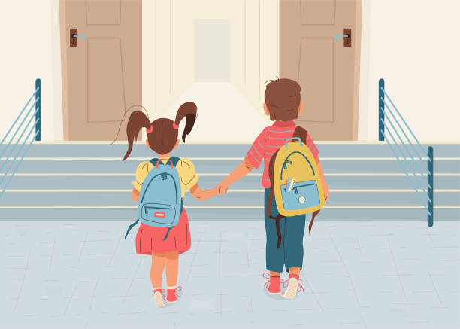
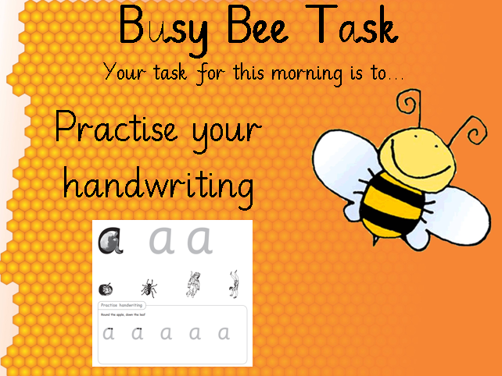
Morning Routine
Doors open at 8.40am
Independent task
School begins at 8.50am
Notes:
Morning routine: Doors open at 8.50, independent Busy Bee task until register at 9
Open door policy:
Staff are available to speak to in the morning and at home time, however if you would like a longer discussion feel free to make an appointment at the school office.

Slide 7

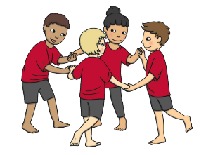


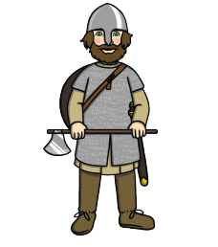
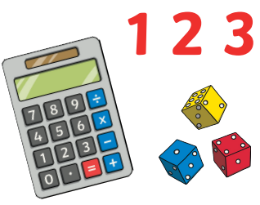
Curriculum
Notes:
Education in Year 1 is more structured than Early Years.
Explicit lessons – RWInc (English), Maths, Science, Geography, History, Art, Music, Computing, D&T, P.E, RE, PSHE.

Slide 8

P.E
Tuesday and Thursday
Children can come to school in their P.E kits on these days
Make sure they bring a water bottle to school
Please ensure EVERYTHING is labelled!
(Even shoes!)
Notes:
Children will usually remove shoes and socks for gymnastic sessions, and also their jumpers and cardigans.
We already have a pile of lost property with no names, which makes it very difficult to reunite with owners!

Slide 9

Interventions
We have a variety of interventions within school.
Some sessions targeting children working at a ‘Greater Depth’, boosting confidence,
‘Pre-teach’, etc.
Children may drop in and out of groups, depending on the need.
Notes:
Some sessions targeting children working at a ‘Greater Depth’, boosting confidence, ‘Pre-teach’, etc.
Can cover academic subjects, like RWInc 1-1, maths or supporting wellbeing, developing motor skills, etc.
Led by different familiar adults (Teachers, STAs, Anna Jones)

Slide 10
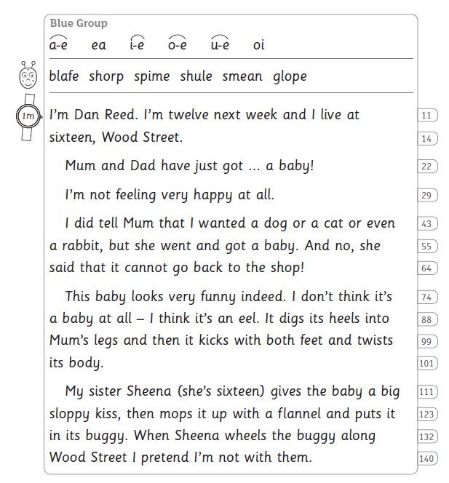
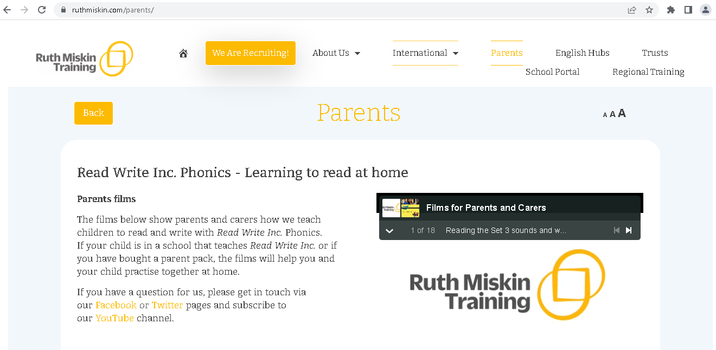
RWInc Groups
All children have been assessed and grouped.
Some children may repeating groups.
Children will be assessed again at
the end of this term.
ruthmiskin.com/parents/
Notes:
All children have been assessed and grouped.
Some children may repeating groups if they do not have the phonic knowledge to move on to the next group. This is why reading at home regularly is so important .
Children are assessed again before the end of the half term, possibly sooner if we think they are progressing very quickly, or are struggling in their current group.
If you are unsure on how to support your child with phonics/reading, lots of free information and videos on Ruth Miskin (creator of RWInc) website.

Slide 11


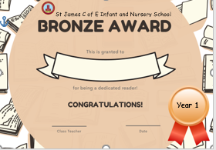
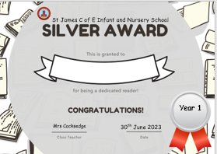
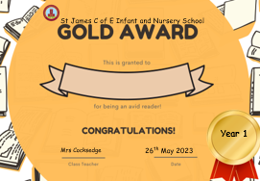
Reading
Read 5 times a week
Variety of texts
Compromise!
Model ‘fantastic reading’
Notes:
One of our main focuses at St James’ is developing a love of reading, reading for pleasure.
Children should be reading at home as often as possible – at least 5 times a week.
Your RWInc books should take priority, as the programme closely matches book to your child’s phonic knowledge, however reading additional library books, magazines, etc is encouraged! The scheme carefully selects words based on phonic knowledge for the colour groupings. The aim of reading these books is for your child to read as a ‘storyteller’, using good expression and intonation. They should also pay attention to punctuation (e.g. pausing for a sufficient amount of time at full stops), and read fluently.
Difference between fluency and comprehension. We need to build fluency in order for children to read without focussing on sounding out words which disrupts the ‘flow’
Reluctant – don’t want argument and associate reading with negatives. Compromise – page each, you start and they finish sentence, read a few pages rather than the whole book, they read a few pages in bed then they choose bedtime story, just read green/red words at start of books, etc
Record in their reading record and bring into school on a Friday Morning to get their reading record stamped/signed. After 6 weeks children will receive Bronze Award, then Silver and Gold where the children reading a reading book to keep.
It is just as important for children to hear you read to them. Model ‘fantastic reading’.

Slide 12


Homework
Spellings are put on Seesaw on a Friday. These are to be practised at home for the following Friday.
Spellings are also on Spelling Shed which allows children to practise their spellings online by playing games.
Notes:
We have made the decision to transition towards an optional homework policy
Spellings will be uploaded to Seesaw on a Friday. You will have received a note telling you which set of spellings, and how many of these they are to practice. Please practice all week in preparation for following Friday when they will be checked. You can also use Spelling Shed to further practise.
.
Note: When writing, we encourage children to ‘use Fred Fingers’ and sound out words, but correct them if the common exception words are incorrect, or if we feel they should know the spelling.

Slide 13
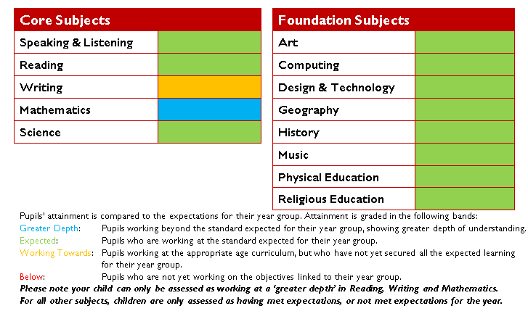
Assessment
Notes:
At the end of Key Stage 1, children are assessed as:
* Pre-Key Stage
* Working towards the expected standard
* Working at the expected standard
* Working at a greater depth within the expected standard.
Children have to consistently demonstrate their ability to meet the criteria points independently to achieve the standard.
In Year 1, we assess them against how ‘on track’ they are to meet the expected standard. This may change over time. Children may be greater depth in Year 1, but struggle to consistently meet all of the Year 2 objectives. Likewise, some children may be ‘working towards’ in Year 1, but make brilliant progress and meet the expected standard in Year 2.

Slide 14
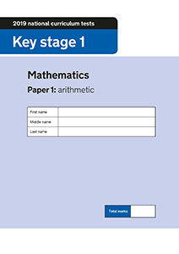
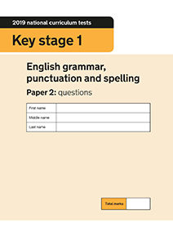
SATS
.
Notes:
The Key Stage 1 SATs officially assess your child’s maths and English abilities. Although these are formal tests, they are done in a relaxed way; in fact, most children are not even aware they’re taking a test!
There are a number of elements to the KS1 SATS tests, including maths, reading and English grammar, punctuation and spelling.
Think of Key Stage 1 SATs as evaluations rather than exams – they’re not designed to be passed or failed, and they gauge what level your child has reached rather than whether or not they meet the standards set in the test. It’s another way to highlight where your child is doing well, and where they might need extra help.

Slide 15
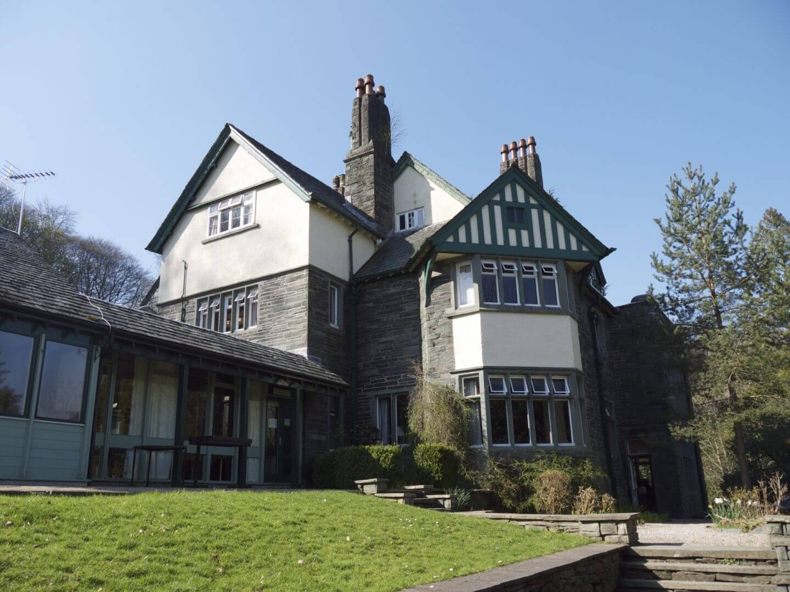
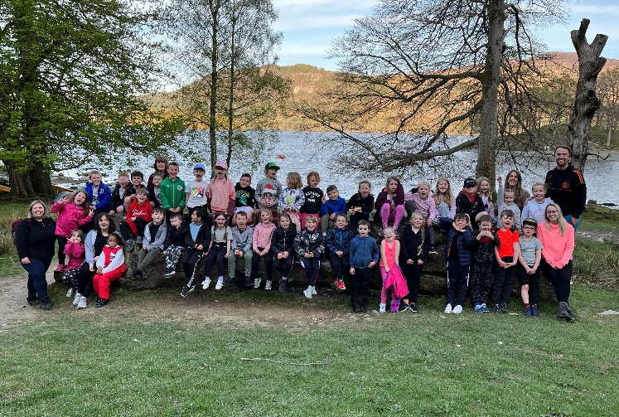
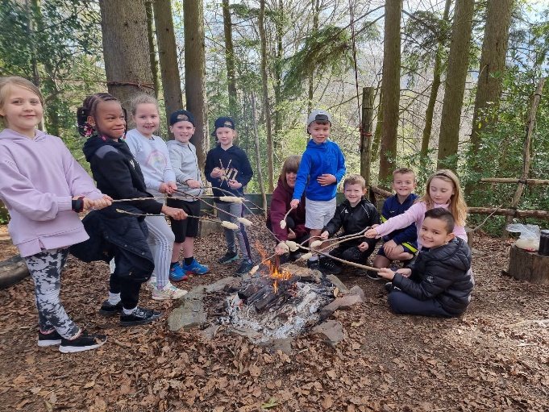
Hawse End
.
Notes:
Experience a residential trip.
Develop problem solving skills.
Develop child’s independence.
Explore new learning opportunities.
Gain new experiences.

Slide 16

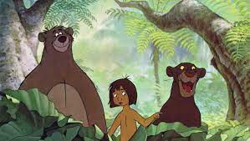
Jungle Book
.
Notes:
Summer Term
Only Year 2’s

Slide 17
How can you help?
Encourage your children to discuss their learning.
Read a variety of texts to and with your children – not just school books.
Continue to practise areas of difficulty that your child may be experiencing.
Make each learning experience as enjoyable as possible.
If you have a question please come and speak to us!
Meetings will be held that explain teaching methods used.

Slide 18

Open door policy
Please come to see us if you have any questions, or would like to speak to us about anything!

