Slide 1

Year 1
Information Meeting

Slide 2
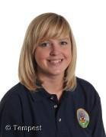
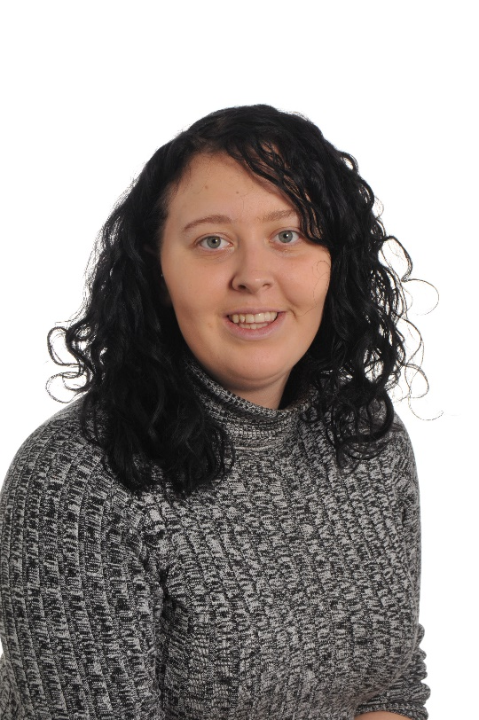
Meet the Staff...
Scafell
Mrs Jenny King
Miss Eloise Cocksedge

Slide 3
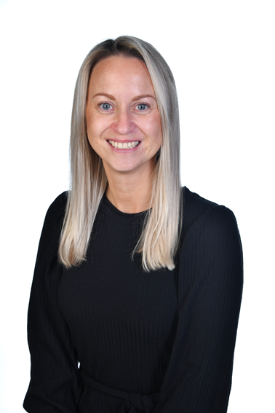
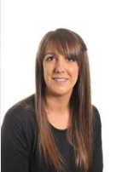
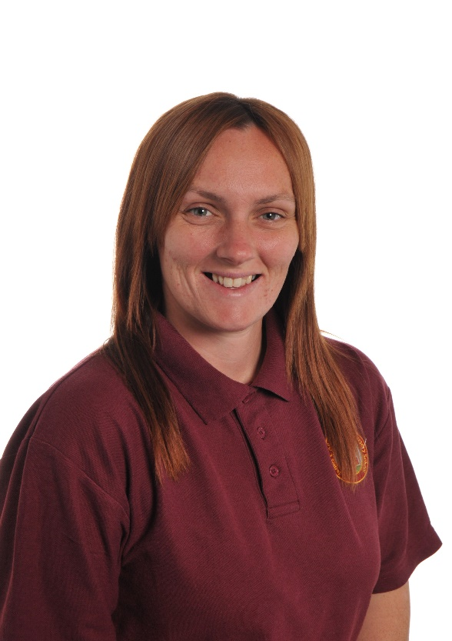
Meet the Staff...
Skiddaw
Mrs Emma Butterworth
(Mon – Wed)
Miss Kimberley Powell
(Wed – Fri)
Miss Jemma
Deans

Slide 4

Transition from EYFS
Notes:
It’s always a big jump from Reception to Year 1
Aware that this year is very different to previous years! Focus on wellbeing and building relationships.
Key Stage 1 is more structured than the Early Years.
Focus on becoming more independent learners.
Expectations of children are very high, which we need to ensure they are able to access the curriculum set by the Government.

Slide 5
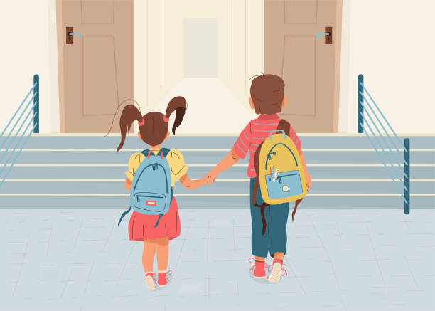
Morning Routine
School begins at 8.40am
Handwriting session
8.40-8.55
Notes:
Morning routine: Doors open at 8.40, independent Busy Bee task until register Open door policy:
Staff are available to speak to in the morning and at home time, however if you would like a longer discussion feel free to make an appointment at the school office.

Slide 6

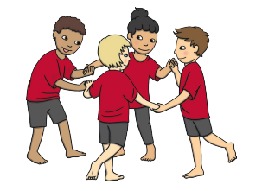


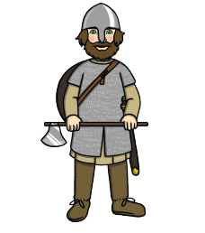
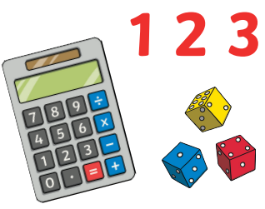
Curriculum
Notes:
Education in Year 1 is more structured than Early Years.
Explicit lessons – RWInc (English), Maths, Science, Geography, History, Art, Music, Computing, D&T, P.E, RE, PSHE.

Slide 7

P.E
Thursday and Friday
Children must come to school in their P.E kits on these days
Make sure they bring a water bottle to school
Please ensure EVERYTHING is labelled!
(Even shoes!)
Notes:
Children will usually remove shoes and socks for gymnastic sessions, and also their jumpers and cardigans.
We already have a pile of lost property with no names, which makes it very difficult to reunite with owners!

Slide 8

Interventions
We have a variety of interventions within school.
Children may drop in and out of groups,
depending on the need.
Notes:
Some sessions targeting children working at a ‘Greater Depth’, boosting confidence, ‘Pre-teach’, etc.
Can cover academic subjects, like RWInc 1-1, maths or supporting wellbeing, developing motor skills, etc.
Led by different familiar adults (Teachers, STAs, Anna Jones)
20%

Slide 9
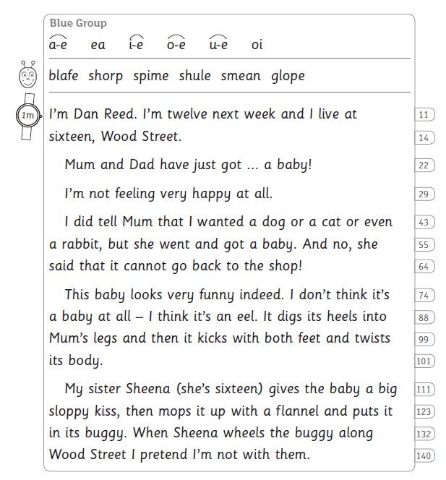
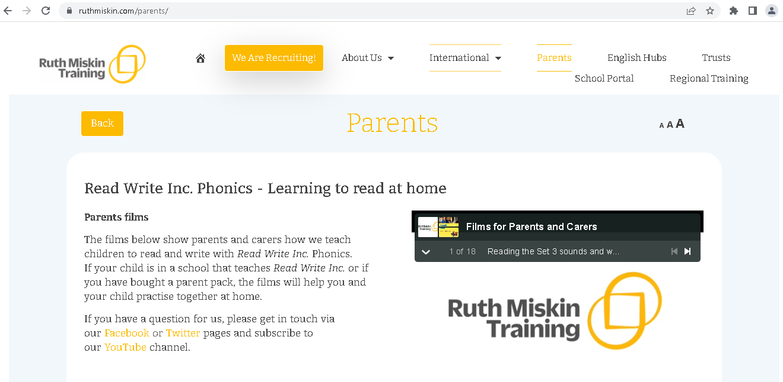
RWInc Groups
All children have been assessed and grouped.
Some children may repeating groups.
Children will be assessed again at
the end of this term.
ruthmiskin.com/parents/
Notes:
All children have been assessed and grouped.
Some children may repeating groups if they do not have the phonic knowledge to move on to the next group. This is why reading at home regularly is so important .
Children are assessed again before the end of the half term, possibly sooner if we think they are progressing very quickly, or are struggling in their current group.
If you are unsure on how to support your child with phonics/reading, lots of free information and videos on Ruth Miskin (creator of RWInc) website.

Slide 10


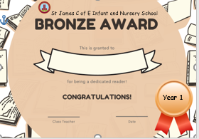
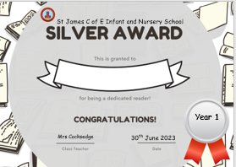

Reading
Read 3 times a week
(ideally 5)
Variety of texts
Compromise!
Model ‘fantastic reading’
Notes:
One of our main focuses at St James’ is developing a love of reading, reading for pleasure.
Children should be reading at home as often as possible – at least 5 times a week.
Your RWInc books should take priority, as the programme closely matches book to your child’s phonic knowledge, however reading additional library books, magazines, etc is encouraged! The scheme carefully selects words based on phonic knowledge for the colour groupings. The aim of reading these books is for your child to read as a ‘storyteller’, using good expression and intonation. They should also pay attention to punctuation (e.g. pausing for a sufficient amount of time at full stops), and read fluently.
Difference between fluency and comprehension. We need to build fluency in order for children to read without focussing on sounding out words which disrupts the ‘flow’
Reluctant – don’t want argument and associate reading with negatives. Compromise – page each, you start and they finish sentence, read a few pages rather than the whole book, they read a few pages in bed then they choose bedtime story, just read green/red words at start of books, etc
Record in their reading record and bring into school on a Friday Morning to get their reading record stamped/signed. After 6 weeks children will receive Bronze Award, then Silver and Gold where the children reading a reading book to keep.
It is just as important for children to hear you read to them. Model ‘fantastic reading’.

Slide 11
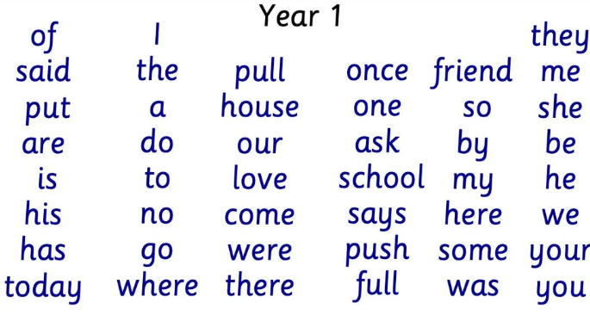
Homework
Research suggests homework has minimal impact at this age
Oracy and discussion are a big focus
Optional tasks on book warmers
Common exception words

Slide 12
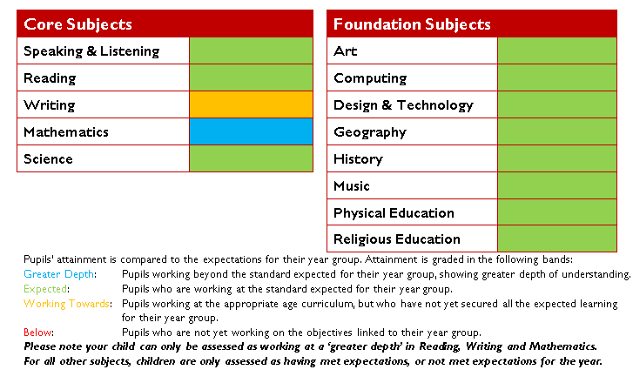
Assessment
Notes:
At the end of Key Stage 1, children are assessed as:
* Pre-Key Stage
* Working towards the expected standard
* Working at the expected standard
* Working at a greater depth within the expected standard.
Children have to consistently demonstrate their ability to meet the criteria points independently to achieve the standard.
In Year 1, we assess them against how ‘on track’ they are to meet the expected standard. This may change over time. Children may be greater depth in Year 1, but struggle to consistently meet all of the Year 2 objectives. Likewise, some children may be ‘working towards’ in Year 1, but make brilliant progress and meet the expected standard in Year 2.

Slide 13

Phonics Screening
.
Notes:
In Summer term, Year 1 children are tested on their ability to blend sounds.
The phonics screening check is a quick and easy check of your child’s phonics knowledge.
Usually done by class teacher and takes a few minutes. If your child is struggling the teacher will stop.
Children who have not met the standard in year 1 will retake the check in year 2, extra steps will be put in place to develop their phonic knowledge.

Slide 14
How can you help?
Encourage your children to discuss their learning.
Read a variety of texts to and with your children – not just school books.
Continue to practise areas of difficulty that your child may be experiencing.
Make each learning experience as enjoyable as possible.
If you have a question please come and speak to us!
Meetings will be held that explain teaching methods used.

Slide 15

Open door policy
Please come to see us if you have any questions, or would like to speak to us about anything!

